Slide 1
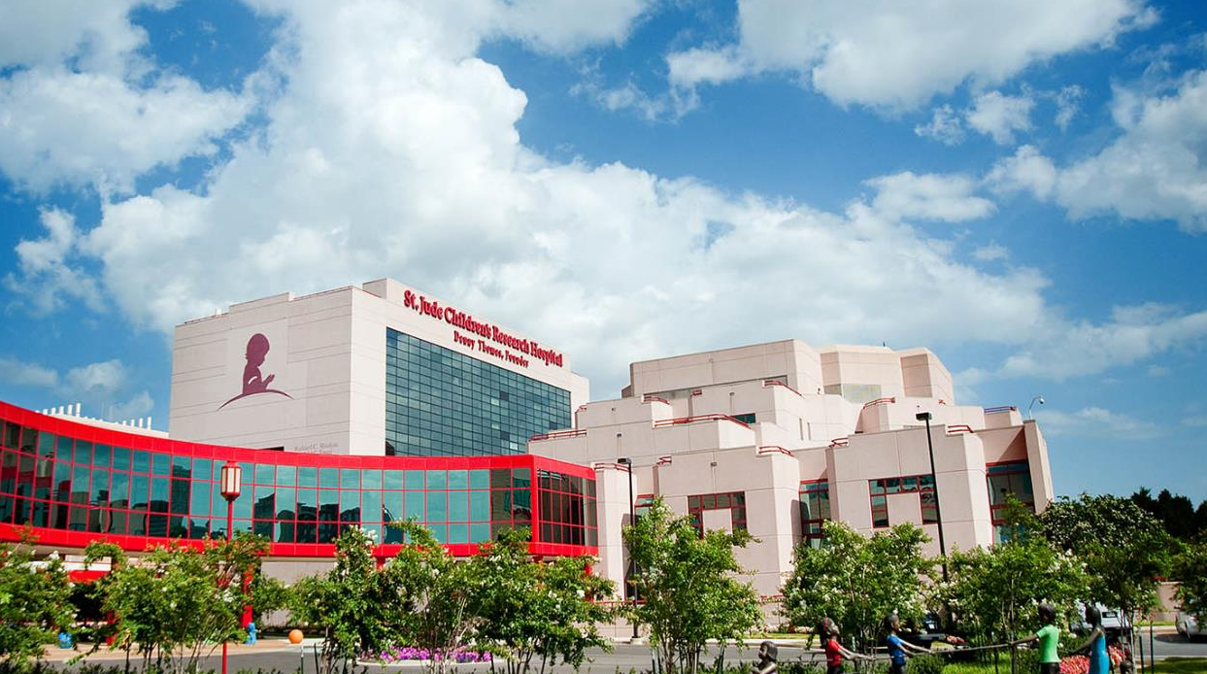

Cancer and Infections:
What? How? Why? & What to do?
Miguela A. Caniza, MD, MPH
Director, Global Infectious Disease Program
Department of Global Pediatric Medicine
St Jude Children’s Research Hospital

Slide 2

FACTS
  Infections in children with cancer delay recovery
  Severe infections can cause death in children with cancer
  How you see your child, or what bothers your child can help you to communicate with your nurses and doctors
  You can help in bringing your child sooner to the hospital
  You can help by practicing good hygiene during the care of your child
M. Caniza 2019

Slide 3
TOPICS
What are infections?
Why cancer can make my child have infection
How are infections produced?
What are the most common types of infections?
How do I know if my child has infection?
What to do to prevent infection?
M. Caniza 2019
Notes:
What? How? Why? & What to do?
Infections in children with cancer delay recovery
Severe infections can cause death in children with cancer
Perceptions of how you see your child, or what bothers your child can help you to communicate with your nurses and doctors.
Hand hygiene practice lowers the risk of acquiring infections
Good care of the skin and mouth prevents infections
Good food preparation prevents certain infectious diarrhea

Slide 4
WHAT ARE Infections?

Slide 5



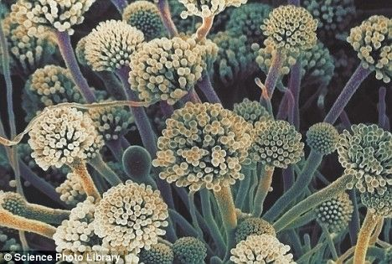

What are infections?
Infections are diseases caused by microbes.
Microbes are small living creatures that cannot be seen by the naked eye.
They reproduce rapidly.
They are called bacteria, viruses, fungi and parasites.
Infections can be serious and sometimes fatal, especially in children with cancer.
M. Caniza 2019
Notes:
A bold proposal that I put forward during the SAB presentation is that:
Every pediatric care institution that treats catastrophic illnesses around the world should have basic standards and resources for infection care and prevention.
Pediatric cancer care cannot be delivered in an unsafe place and St Jude Global should insist that every member of St Jude Global is willing to commit to try to have basic standards and resources for infection care and prevention, this is a right care and it is the best care that will further St Jude mission.
In the next few slides, I’ll share with you some interventions we had done and some encouraging results for this enormous challenge.

Slide 6
Why Cancer can make my child have infections?

Slide 7
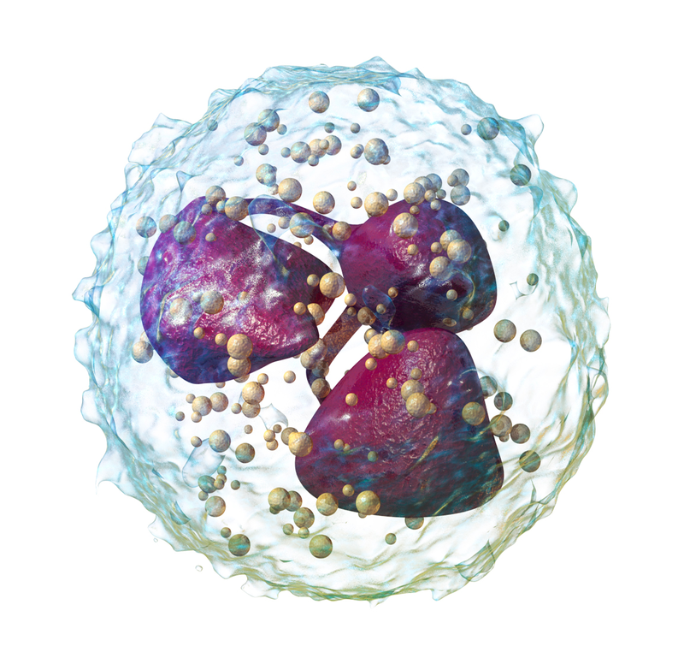
Cancer and its treatment lower resistance to infection
Chemotherapy, or cancer treatment, lowers white blood cells that fight against infections.
When the white blood cell number is very low, it is called neutropenia.
  During neutropenia, there is more chance of infection.
https://en.wikipedia.org/wiki/Neutrophil#/media/File:Blausen_0676_Neutrophil_(crop).png
M. Caniza 2019
Notes:
A bold proposal that I put forward during the SAB presentation is that:
Every pediatric care institution that treats catastrophic illnesses around the world should have basic standards and resources for infection care and prevention.
Pediatric cancer care cannot be delivered in an unsafe place and St Jude Global should insist that every member of St Jude Global is willing to commit to try to have basic standards and resources for infection care and prevention, this is a right care and it is the best care that will further St Jude mission.
In the next few slides, I’ll share with you some interventions we had done and some encouraging results for this enormous challenge.

Slide 8
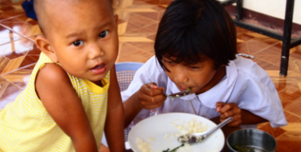
Cancer and its treatment lower resistance to infection
Due to the cancer and chemotherapy, children with cancer cannot eat well (no appetite, stomach and belly ache, diarrhea).
  Your child become malnourished, and is hard to fight infections.
M. Caniza 2019
Notes:
A bold proposal that I put forward during the SAB presentation is that:
Every pediatric care institution that treats catastrophic illnesses around the world should have basic standards and resources for infection care and prevention.
Pediatric cancer care cannot be delivered in an unsafe place and St Jude Global should insist that every member of St Jude Global is willing to commit to try to have basic standards and resources for infection care and prevention, this is a right care and it is the best care that will further St Jude mission.
In the next few slides, I’ll share with you some interventions we had done and some encouraging results for this enormous challenge.

Slide 9
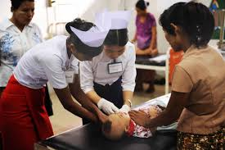
During the cancer treatment there is more opportunity for infection
During chemotherapy children can be ill, stay longer in the hospital, need more attention, and more doctors and nurses
  Your child and their surroundings are touched more often.
Children with cancer need more treatment and laboratory studies
  Your child have blood drawing, and needs catheter in their veins and other foreign materials.
M. Caniza 2019
Notes:
A bold proposal that I put forward during the SAB presentation is that:
Every pediatric care institution that treats catastrophic illnesses around the world should have basic standards and resources for infection care and prevention.
Pediatric cancer care cannot be delivered in an unsafe place and St Jude Global should insist that every member of St Jude Global is willing to commit to try to have basic standards and resources for infection care and prevention, this is a right care and it is the best care that will further St Jude mission.
In the next few slides, I’ll share with you some interventions we had done and some encouraging results for this enormous challenge.

Slide 10
How are infections produced?

Slide 11

Where are the microbes found?
On the body
Outside the body
Skin
  diaper area > axilla > skin
Nose
Mouth
Intestine
Clothes
Linens
Surfaces (highly touched areas)
Air (varicella, tuberculosis, measles)
Food
++
++
++++
M. Caniza 2019
Notes:
A bold proposal that I put forward during the SAB presentation is that:
Every pediatric care institution that treats catastrophic illnesses around the world should have basic standards and resources for infection care and prevention.
Pediatric cancer care cannot be delivered in an unsafe place and St Jude Global should insist that every member of St Jude Global is willing to commit to try to have basic standards and resources for infection care and prevention, this is a right care and it is the best care that will further St Jude mission.
In the next few slides, I’ll share with you some interventions we had done and some encouraging results for this enormous challenge.

Slide 12
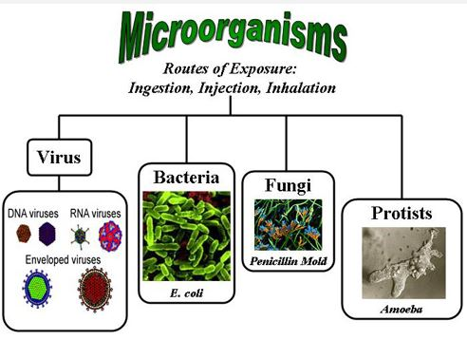
How can your child get microbes?
Touching contaminated surfaces
Eating contaminated food
Breathing air with microbes
Not cleaning hands when this is necessary
Entering through skin and mucosa breakages
M. Caniza 2019
Notes:
A bold proposal that I put forward during the SAB presentation is that:
Every pediatric care institution that treats catastrophic illnesses around the world should have basic standards and resources for infection care and prevention.
Pediatric cancer care cannot be delivered in an unsafe place and St Jude Global should insist that every member of St Jude Global is willing to commit to try to have basic standards and resources for infection care and prevention, this is a right care and it is the best care that will further St Jude mission.
In the next few slides, I’ll share with you some interventions we had done and some encouraging results for this enormous challenge.

Slide 13

Then, what happen?
Once the microbes are inside the body, they reproduce very quickly.
Neutrophils and other cells fight against these microbes.
But, not having these body defenses (neutropenia), the microbes and their waste hurt the organs of the body.
M. Caniza 2019
Notes:
A bold proposal that I put forward during the SAB presentation is that:
Every pediatric care institution that treats catastrophic illnesses around the world should have basic standards and resources for infection care and prevention.
Pediatric cancer care cannot be delivered in an unsafe place and St Jude Global should insist that every member of St Jude Global is willing to commit to try to have basic standards and resources for infection care and prevention, this is a right care and it is the best care that will further St Jude mission.
In the next few slides, I’ll share with you some interventions we had done and some encouraging results for this enormous challenge.

Slide 14
WHAT ARE THE MOST COMMON Types of INFECTION?

Slide 15
Common sites of infection?
M. Caniza 2019

Slide 16
How do I know if my child has an infection, and which are some of the infections?

Slide 17
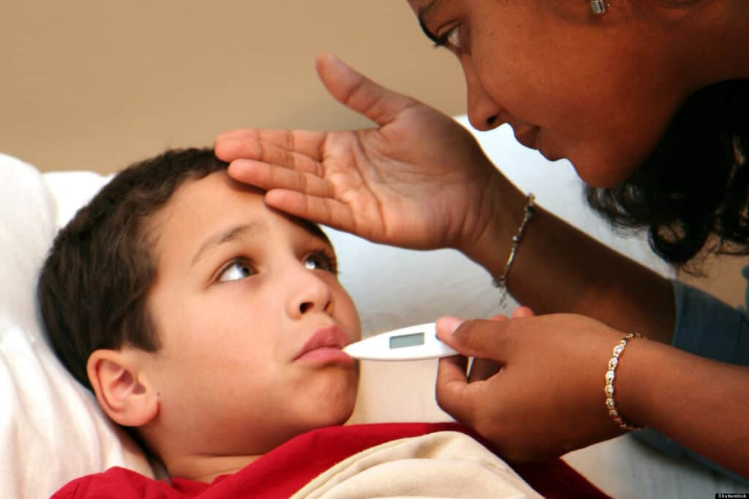
Signs of Infections
Fever
  An oral (by mouth) temperature of 100.9 degrees F (38.3 degrees C) or higher;
  An oral temperature of 100.4 degrees F (38.0 degrees C) or higher that lasts for one hour;
  An under-the-arm (axillary) temperature of 99.9 degrees F (37.7 degrees C); or
  An under-the-arm temperature of 99.4 degrees F (37.4 degrees C) or higher that lasts for one hour.
M. Caniza 2019
Notes:
A bold proposal that I put forward during the SAB presentation is that:
Every pediatric care institution that treats catastrophic illnesses around the world should have basic standards and resources for infection care and prevention.
Pediatric cancer care cannot be delivered in an unsafe place and St Jude Global should insist that every member of St Jude Global is willing to commit to try to have basic standards and resources for infection care and prevention, this is a right care and it is the best care that will further St Jude mission.
In the next few slides, I’ll share with you some interventions we had done and some encouraging results for this enormous challenge.

Slide 18
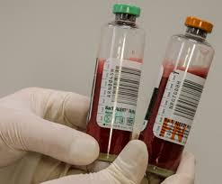
Blood infections
These are the most serious infections
Your child can have fever,
Also they can have other symptoms such as belly ache, not feeling well, get very sleepy,
Your child might say something that does not make much sense
Your child might not look well
You sense that something is not right with your child
M. Caniza 2019
Notes:
A bold proposal that I put forward during the SAB presentation is that:
Every pediatric care institution that treats catastrophic illnesses around the world should have basic standards and resources for infection care and prevention.
Pediatric cancer care cannot be delivered in an unsafe place and St Jude Global should insist that every member of St Jude Global is willing to commit to try to have basic standards and resources for infection care and prevention, this is a right care and it is the best care that will further St Jude mission.
In the next few slides, I’ll share with you some interventions we had done and some encouraging results for this enormous challenge.

Slide 19
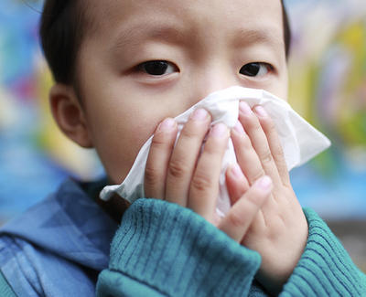
Respiratory infections
Respiratory infections
  Pneumonia, sinusitis, influenza, colds
Your child can have fever
Your child can have cough
Your child can have , running nose, fast breathing
Some times they can also can have belly ache, chest pain
M. Caniza 2019
Notes:
A bold proposal that I put forward during the SAB presentation is that:
Every pediatric care institution that treats catastrophic illnesses around the world should have basic standards and resources for infection care and prevention.
Pediatric cancer care cannot be delivered in an unsafe place and St Jude Global should insist that every member of St Jude Global is willing to commit to try to have basic standards and resources for infection care and prevention, this is a right care and it is the best care that will further St Jude mission.
In the next few slides, I’ll share with you some interventions we had done and some encouraging results for this enormous challenge.

Slide 20

Belly infections
Stomach and intestine infections
  Colitis, enteritis, diarrhea
Your child also can have fever
Your child can have diarrhea, belly ache, vomiting, pain when passing stool
Sometimes, your child can have sores around the anus
M. Caniza 2019
Notes:
A bold proposal that I put forward during the SAB presentation is that:
Every pediatric care institution that treats catastrophic illnesses around the world should have basic standards and resources for infection care and prevention.
Pediatric cancer care cannot be delivered in an unsafe place and St Jude Global should insist that every member of St Jude Global is willing to commit to try to have basic standards and resources for infection care and prevention, this is a right care and it is the best care that will further St Jude mission.
In the next few slides, I’ll share with you some interventions we had done and some encouraging results for this enormous challenge.

Slide 21
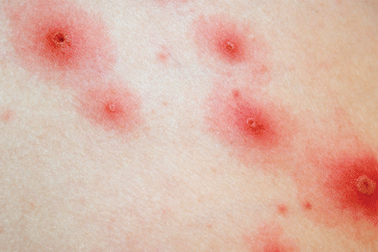
Skin infections
These could be rash, swollen and red skin, lesions with blisters or pus, blue / black dots
  Causes could be bacterial, virus, fungus
Your child also can have fever or not
Your child might have pain or itchiness at the site of the infection
If your child develops an infection while he has neutropenia, a tiny bump could mean something is wrong, and pus, redness, and swelling may not always be present.
.
M. Caniza 2019
Notes:
A bold proposal that I put forward during the SAB presentation is that:
Every pediatric care institution that treats catastrophic illnesses around the world should have basic standards and resources for infection care and prevention.
Pediatric cancer care cannot be delivered in an unsafe place and St Jude Global should insist that every member of St Jude Global is willing to commit to try to have basic standards and resources for infection care and prevention, this is a right care and it is the best care that will further St Jude mission.
In the next few slides, I’ll share with you some interventions we had done and some encouraging results for this enormous challenge.

Slide 22
What should I do if I think my child might have an infection?

Slide 23
What to do?
What to do?
  If you have a thermometer, you can take the temperature
  Have everything ready to come to the hospital
  When you arrive to the hospital, make sure that you tell the doctors and nurses that your child has cancer and needs a quick care
  Don’t wait in the waiting area for a long time
M. Caniza 2019
Notes:
A bold proposal that I put forward during the SAB presentation is that:
Every pediatric care institution that treats catastrophic illnesses around the world should have basic standards and resources for infection care and prevention.
Pediatric cancer care cannot be delivered in an unsafe place and St Jude Global should insist that every member of St Jude Global is willing to commit to try to have basic standards and resources for infection care and prevention, this is a right care and it is the best care that will further St Jude mission.
In the next few slides, I’ll share with you some interventions we had done and some encouraging results for this enormous challenge.

Slide 24

What to do to prevent infection in my child?

Slide 25
Hand Hygiene
Hand rubbing
You can use alcohol gel, but if the hands are dirty, wash them with soap and water and use clean towel.
Hand washing with soap and water
  Get your hands wet.
  Use liquid soap or bar soap.
  Work up a good lather.
  Rub your hands for 15–20 seconds.
  Rinse your hands with your palms down.
  Dry your hands with a clean cloth towel.
M. Caniza 2019
Notes:
A bold proposal that I put forward during the SAB presentation is that:
Every pediatric care institution that treats catastrophic illnesses around the world should have basic standards and resources for infection care and prevention.
Pediatric cancer care cannot be delivered in an unsafe place and St Jude Global should insist that every member of St Jude Global is willing to commit to try to have basic standards and resources for infection care and prevention, this is a right care and it is the best care that will further St Jude mission.
In the next few slides, I’ll share with you some interventions we had done and some encouraging results for this enormous challenge.

Slide 26

Mouth hygiene, oral care
Visit the dentist
Dental and mouth care during chemotherapy treatment:
  Brushing after every meal and before bed
  Clean teeth, and between teeth
  Use soft brush
The most important thing to do, is clean the mouth
Avoid irritating, abrasive, hot, spicy and hard foods
Keep mouth and lips well-moisturized
Use of mild antiseptic mouthwash
  Peroxyl
  Chlorhexidine
M. Caniza 2019
Notes:
A bold proposal that I put forward during the SAB presentation is that:
Every pediatric care institution that treats catastrophic illnesses around the world should have basic standards and resources for infection care and prevention.
Pediatric cancer care cannot be delivered in an unsafe place and St Jude Global should insist that every member of St Jude Global is willing to commit to try to have basic standards and resources for infection care and prevention, this is a right care and it is the best care that will further St Jude mission.
In the next few slides, I’ll share with you some interventions we had done and some encouraging results for this enormous challenge.

Slide 27
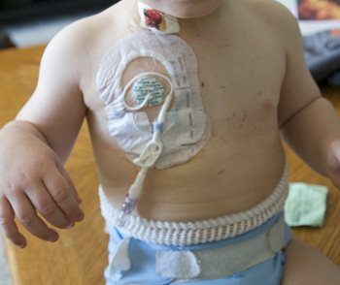
Catheter care
Avoid touching catheter,
If you will touch catheter, wash your hands or use alcohol gel.
If exit site of catheter is becoming red, painful, or there is a discharge, tell your doctor or nurse.
Do not wet the catheter site.
M. Caniza 2019
Notes:
A bold proposal that I put forward during the SAB presentation is that:
Every pediatric care institution that treats catastrophic illnesses around the world should have basic standards and resources for infection care and prevention.
Pediatric cancer care cannot be delivered in an unsafe place and St Jude Global should insist that every member of St Jude Global is willing to commit to try to have basic standards and resources for infection care and prevention, this is a right care and it is the best care that will further St Jude mission.
In the next few slides, I’ll share with you some interventions we had done and some encouraging results for this enormous challenge.

Slide 28

Avoiding people with infections
Avoid contact and close proximity (without protection) around people that have a cold
Avoid people with chicken pox or and type of rash
  notify your doctor immediately if this occurs!
If the patient attends classes, tell the teacher to let you know if someone has chickenpox
Avoid people with jaundice (yellow skin color)
M. Caniza 2019
Notes:
A bold proposal that I put forward during the SAB presentation is that:
Every pediatric care institution that treats catastrophic illnesses around the world should have basic standards and resources for infection care and prevention.
Pediatric cancer care cannot be delivered in an unsafe place and St Jude Global should insist that every member of St Jude Global is willing to commit to try to have basic standards and resources for infection care and prevention, this is a right care and it is the best care that will further St Jude mission.
In the next few slides, I’ll share with you some interventions we had done and some encouraging results for this enormous challenge.

Slide 29
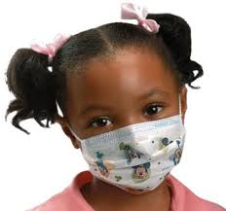
How not to catch infections
If neutropenic, when going to big crowded areas:
  wear mask, this will prevent in touching face
Do hand hygiene using alcohol gel often.
Wipe surfaces with cloth with disinfectants if visitors with cold.
Ask the doctor if your child can receive vaccines.
Also, ask the doctor to tell you what kind of vaccines you and your other children can receive
M. Caniza 2019
Notes:
A bold proposal that I put forward during the SAB presentation is that:
Every pediatric care institution that treats catastrophic illnesses around the world should have basic standards and resources for infection care and prevention.
Pediatric cancer care cannot be delivered in an unsafe place and St Jude Global should insist that every member of St Jude Global is willing to commit to try to have basic standards and resources for infection care and prevention, this is a right care and it is the best care that will further St Jude mission.
In the next few slides, I’ll share with you some interventions we had done and some encouraging results for this enormous challenge.

Slide 30

Safe food
Avoid contaminated waters, boiling or filtering is preferred to avoid possible organisms
Thoroughly cooked meals
Avoid raw or barely cooked meals
Avoid unpasteurized products
Thoroughly wash fruits and vegetables
Avoid raw meat contact with prepared foods
M. Caniza 2019
Notes:
A bold proposal that I put forward during the SAB presentation is that:
Every pediatric care institution that treats catastrophic illnesses around the world should have basic standards and resources for infection care and prevention.
Pediatric cancer care cannot be delivered in an unsafe place and St Jude Global should insist that every member of St Jude Global is willing to commit to try to have basic standards and resources for infection care and prevention, this is a right care and it is the best care that will further St Jude mission.
In the next few slides, I’ll share with you some interventions we had done and some encouraging results for this enormous challenge.

Slide 31
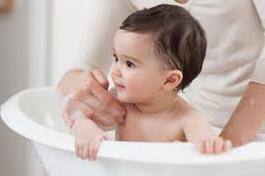
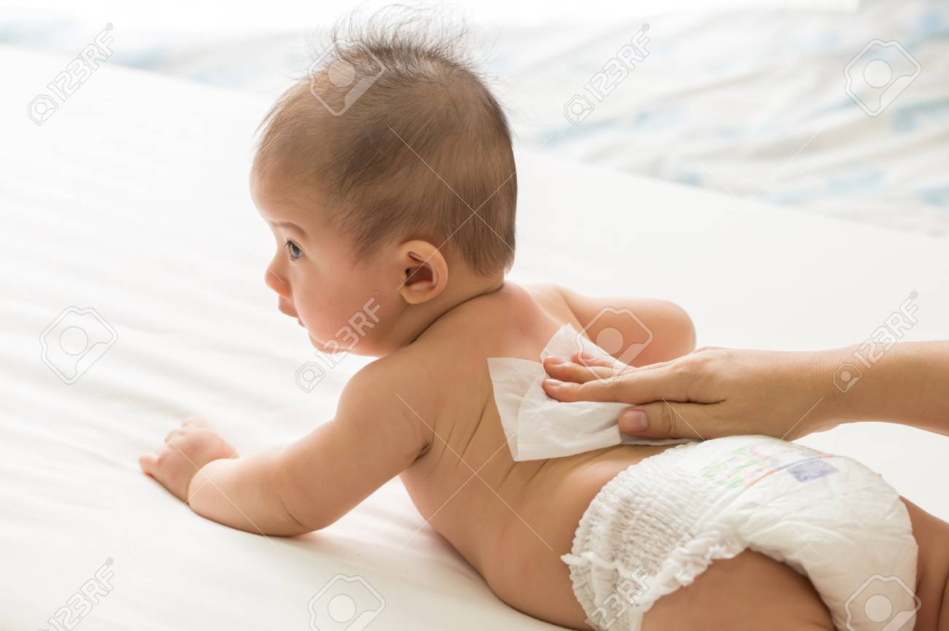
Body Hygiene
Daily body cleaning, take an opportunity to check the skins and to ask questions if anything is hurting them.
Use regular soap and water at a comfortable temperature.
Use wet clean cloth, going to areas of less contamination, and finishing in areas with more contamination
M. Caniza 2019
Notes:
A bold proposal that I put forward during the SAB presentation is that:
Every pediatric care institution that treats catastrophic illnesses around the world should have basic standards and resources for infection care and prevention.
Pediatric cancer care cannot be delivered in an unsafe place and St Jude Global should insist that every member of St Jude Global is willing to commit to try to have basic standards and resources for infection care and prevention, this is a right care and it is the best care that will further St Jude mission.
In the next few slides, I’ll share with you some interventions we had done and some encouraging results for this enormous challenge.

Slide 32

Clean clothes, pajamas and bed linens
Change clothes daily
Change pajamas often
Change bed linens often
Wash and dry them
M. Caniza 2019
Notes:
A bold proposal that I put forward during the SAB presentation is that:
Every pediatric care institution that treats catastrophic illnesses around the world should have basic standards and resources for infection care and prevention.
Pediatric cancer care cannot be delivered in an unsafe place and St Jude Global should insist that every member of St Jude Global is willing to commit to try to have basic standards and resources for infection care and prevention, this is a right care and it is the best care that will further St Jude mission.
In the next few slides, I’ll share with you some interventions we had done and some encouraging results for this enormous challenge.

Slide 33
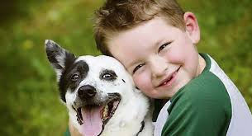
Pets
Avoid contact with young cats and dogs
Avoid contact with turtles, snakes, iguanas
Avoid contact with birds, chicken
Hand hygiene after contacts with pets
M. Caniza 2019
Notes:
A bold proposal that I put forward during the SAB presentation is that:
Every pediatric care institution that treats catastrophic illnesses around the world should have basic standards and resources for infection care and prevention.
Pediatric cancer care cannot be delivered in an unsafe place and St Jude Global should insist that every member of St Jude Global is willing to commit to try to have basic standards and resources for infection care and prevention, this is a right care and it is the best care that will further St Jude mission.
In the next few slides, I’ll share with you some interventions we had done and some encouraging results for this enormous challenge.

Slide 34
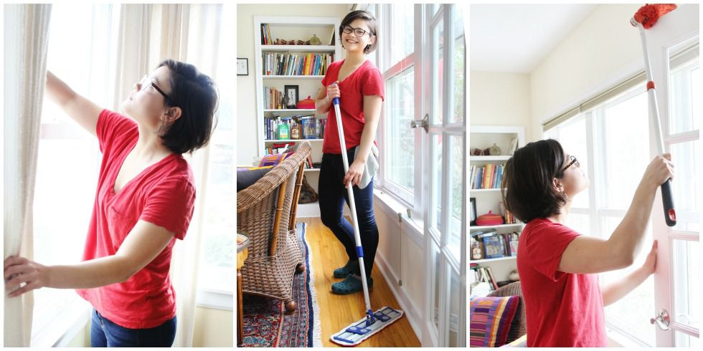
Home
Clean horizontal surfaces with damp cloths
Best toys are those that can be washed
Don’t have in door plants
Avoid freshly cut flowers
M. Caniza 2019
Notes:
A bold proposal that I put forward during the SAB presentation is that:
Every pediatric care institution that treats catastrophic illnesses around the world should have basic standards and resources for infection care and prevention.
Pediatric cancer care cannot be delivered in an unsafe place and St Jude Global should insist that every member of St Jude Global is willing to commit to try to have basic standards and resources for infection care and prevention, this is a right care and it is the best care that will further St Jude mission.
In the next few slides, I’ll share with you some interventions we had done and some encouraging results for this enormous challenge.

Slide 35
Conclusions

Slide 36
Conclusion
Children with cancer are more susceptible to infections
Avoiding infections improve the possibility of recovery of children with cancer
It is very important to avoid infections during chemotherapy:
  Hand hygiene
  Good body and dental hygiene
  Good catheter handling
  Clean and well prepared foods
  Avoid contact with sick people
  Follow pet’s recommendations
M. Caniza 2019
Notes:
A bold proposal that I put forward during the SAB presentation is that:
Every pediatric care institution that treats catastrophic illnesses around the world should have basic standards and resources for infection care and prevention.
Pediatric cancer care cannot be delivered in an unsafe place and St Jude Global should insist that every member of St Jude Global is willing to commit to try to have basic standards and resources for infection care and prevention, this is a right care and it is the best care that will further St Jude mission.
In the next few slides, I’ll share with you some interventions we had done and some encouraging results for this enormous challenge.

Slide 37


Any questions?

