Slide 1
The Role of Parents and Families in Caring for Children/Adolescents with Cancer
Carmen Vallejo Auste
Global President, Childhood Cancer International
WHO Geneva Task Force on Childhood Cancer
Managing Director, Cancer Warriors Foundation
Mother of a Teen Brain Cancer Survivor

Slide 2
“There are only four kinds of people in the world. Those who have been caregivers. Those who are currently caregivers. Those who will be caregivers, and those who will need a caregiver.”

Slide 3
Only when you have walked in my shoes can you truly understand me
Only when you have seen through my eyes can you feel what I feel

Slide 4
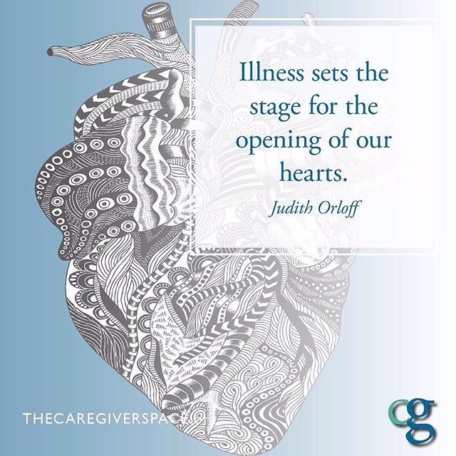
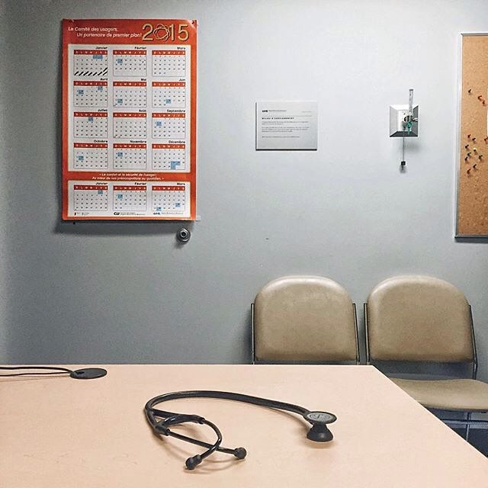
People become carers in different ways. For cancer, its through those 4 words.

Slide 5
Why Patients and Families Matter
The most valuable untapped resource for improving healthcare is the knowledge wisdom, and energy of individuals, families, and communities who face challenging health issues in their everyday lives.
Patients and families are the greatest untapped resource in our quest to achieve the triple aim of better health, better care, and lower costs
Patients and families are important stakeholders in health care,
they have the most at stake
a growing body of evidence shows that their engagement leads to better health outcomes

Slide 6
Parents and Family members are not just companions and hospital visitors. They are carers and an integral part of the multidisciplinary team.
They give comfort, encouragement and reassurance to the person they care for.
They oversee their health and wellbeing, monitor their safety and help them stay as independent as possible.
Often the extent of the support provided by carers isn't obvious to those around them.
Even family and friends can underestimate the amount of time and energy spent caring, particularly when the kinds of assistance given aren't physical.

Slide 7
Patient and Family Centered Care
a partnership among medical practitioners, patients, and their families to ensure that decisions respect patients’ wants, needs, and preferences and that patients have the education and support they need to make decisions and participate in their own care (Institute of Medicine, Washington, DC).

Slide 8
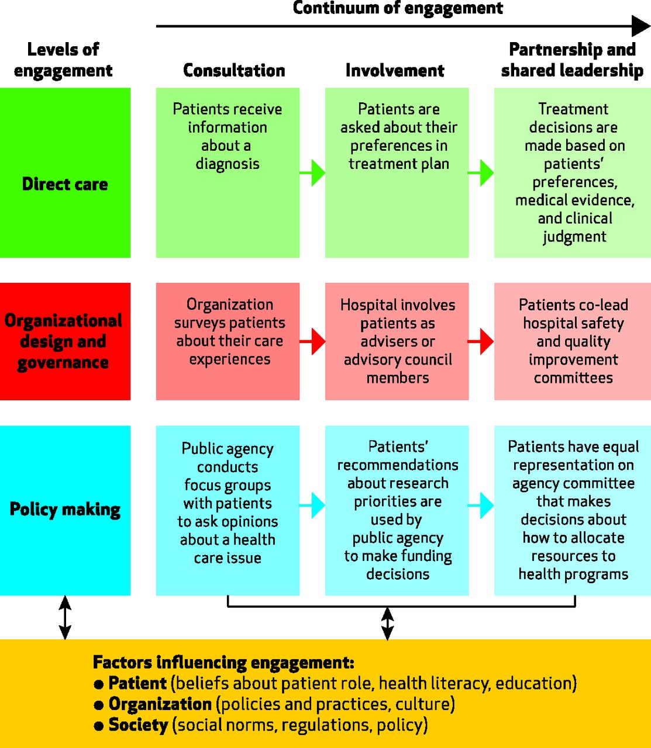
A Multidimensional Framework For Patient And Family Engagement In Health And Health Care.
Kristin L. Carman et al. Health Aff 2013;32:223-231
©2013 by Project HOPE - The People-to-People Health Foundation, Inc.
Notes:
A Multidimensional Framework For Patient And Family Engagement In Health And Health CareA Multidimensional Framework For Patient And Family Engagement In Health And Health Careembed patient and family engagement
in formal structures within the organization – structures such as advisor programs.
Organizations should routinely require consultation with patients and families for
certain tasks; for example, seeking their advice on the design of patient education
materials is particularly important

Slide 9
Being a carer is challenging.
Being a carer can be very demanding and often restricts the lives of carers and their families.
It also has long term effects on their physical, emotional and psychological well-being.

Slide 10
WHO ARE YOUNG CARERS?
Young carers are children and young people up to 25 years of age who
provide care and support for someone in their family who has
a life threatening or life limiting disease
a disability
a mental health issue or
other chronic health problems.
They also take in additional responsibilities in the family and in the home .
They carry on , in a regular basis, significant and substantial caring tasks such as emotional support, personal care, managing the house, sibling care or support

Slide 11
“There were times when doctors would ask me to leave the room to discuss things with my family. This just made me feel excluded within the family.”
WHAT YOUNG CARERS NEED
Keep Me Informed
Even young children in a family sense when something is different or when something is wrong.
With children of any age, it is always better to talk it over in words they can understand than trying to hide it.

Slide 12
It isn’t your fault your brother/sister/mom/dad … is sick .. You cannot always make it better… Worrying wont change what will happen but it is ok to feel freaked out.. Don’t be embarrassed or ashamed to tell me/us how you feel.. It’s OK to ask for help and to need help dealing with things because it affects you too.
WHAT YOUNG CARERS NEED
Reassure Me.

Slide 13
“Mainly I felt emotionally drained and put the rest of my life on hold because I just didn’t feel important anymore. All of the attention was on .. I felt lost...alone ..neglected ”
WHAT YOUNG CARERS NEED
Show you care and still love me.
Show me that I am still special .
Make me feel I am part of this journey and that I am not alone.

Slide 14
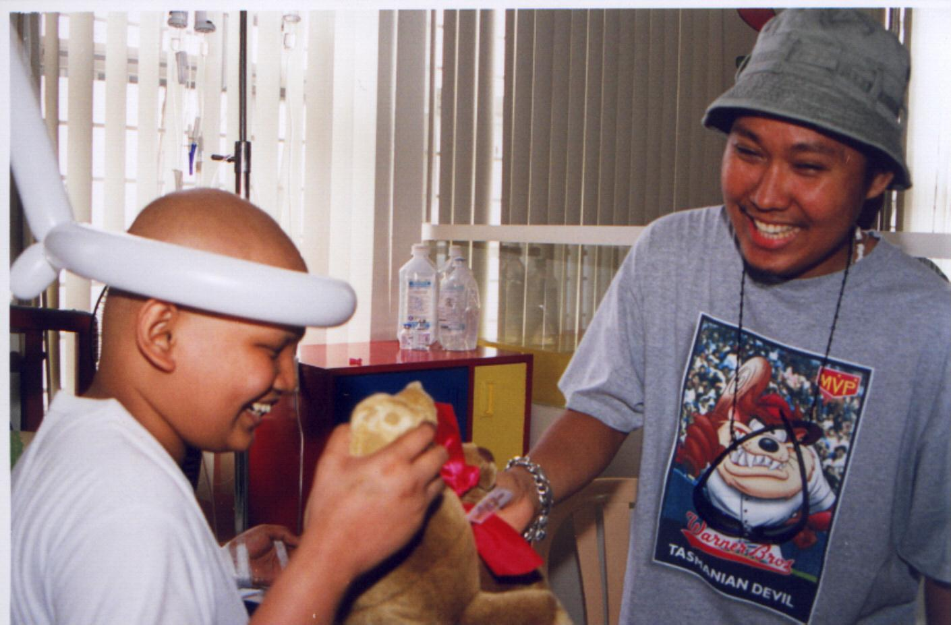
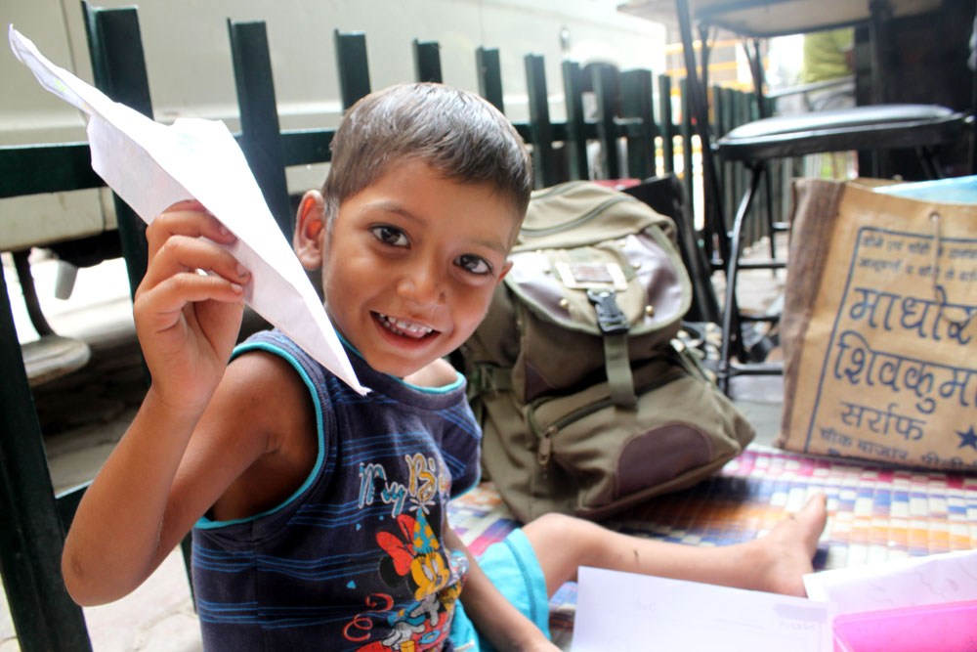
Children are not little adults; They have unique needs.
Children are not simply little adults!
Serious illness is not a “normal” condition for most children.
Medical decisions for young children are usually made by their parents & caregivers.
Young adults (15-20 year olds) are IN BETWEEN ..... neither pediatric, nor adult oncology patients

Slide 15
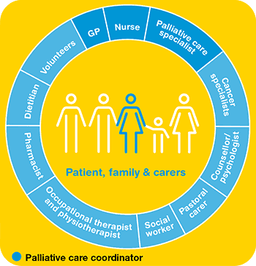
The family of someone with cancer, especially a child /adolescent with cancer needs A CARING CIRCLE of SUPPORT , all of us – working closely together
No one can understand and share the childhood cancer journey better than a parent, sibling or family member , who has experienced it
Parent, Family. Survivor Groups are your partners in the journey; they are connectors and bridges to other resources

Slide 16
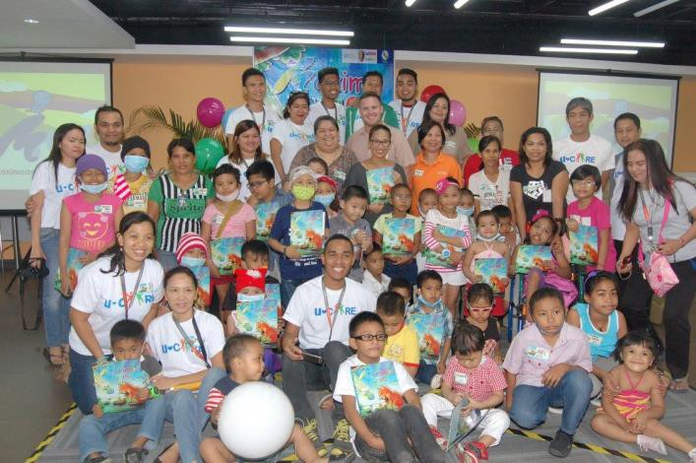
Types of Support Family and Parent Groups Provide
2.
Patient Navigation, Follow-Up and Tracking
Helping newly diagnosed families to negotiate the complexities of the healthcare system, and make their way through the hospital maze
Reminding them of their treatment and follow up schedules; Connecting families with needed resources
Relating to the families in a language that is common and shared.
1.Emotional Support
Creating Moments of Joy and Hope
Spending time with the families;
Fulfilling the wishes of a child;
Celebrating festivals and birthdays, arranging for picnics and outings for the children and their families.;
Caring for Carers; respite time for families

Slide 17
Types of Support Family and Parent Groups Provide
4. Financial:
4.1. Direct Treatment Support
Providing financial assistance or making available childhood cancer drugs, supportive care needs, pain medication,
Pay assistance for treatment: chemo, radiation, surgery
Pay assistance for laboratory tests and allied services
Providing or paying for physical therapy; rehabilitation or reintegration services ; home based care or hospice care
4.2 Transportation Assistance
4.3 Educational Assistance
3. Practical and Life line Support
Coaching and training on various aspects of patient care and supportive care, nutritional practices, infection control, symptom management;
Information on sources of financial support and other forms of patient/family assistance;
Assistance with household tasks, with maintaining a sense of normalcy and continuity ;
Assistance in sharing age and condition appropriate information to family members;

Slide 18
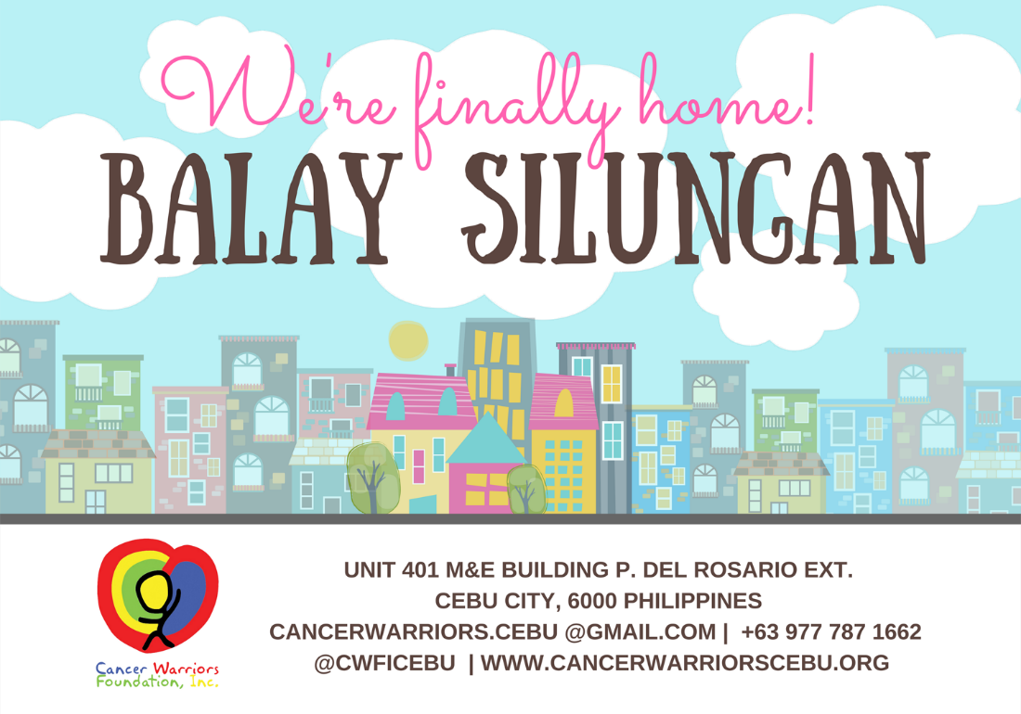
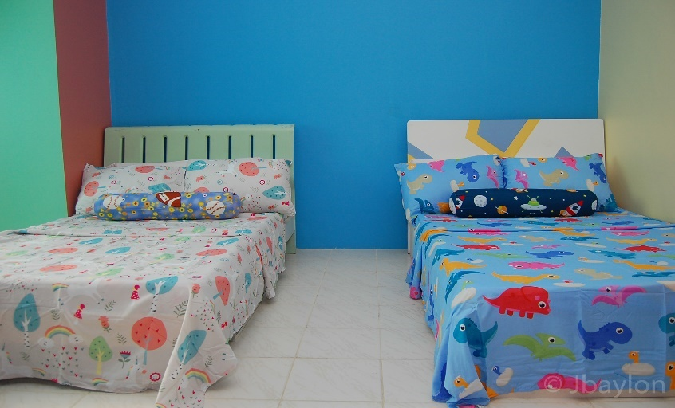
Types of Support Family and Parent Groups Provide .. 5. Transient Homes
Y

Slide 19
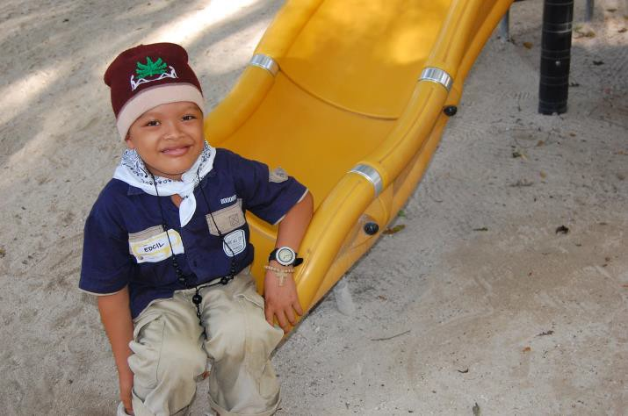
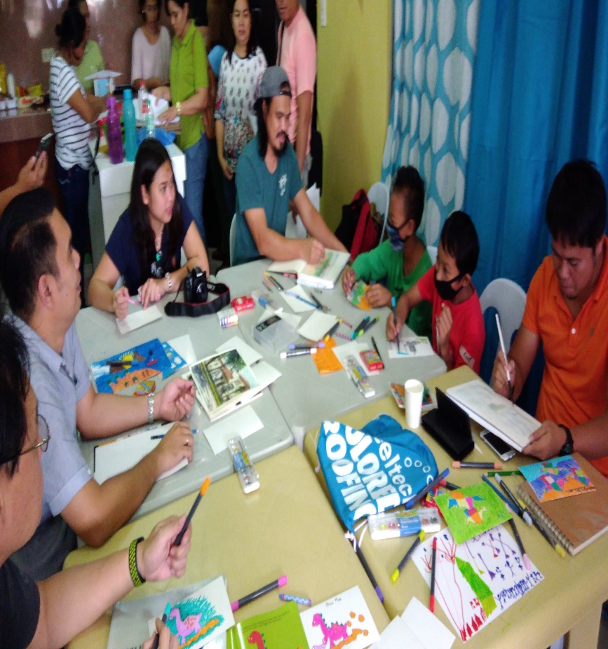
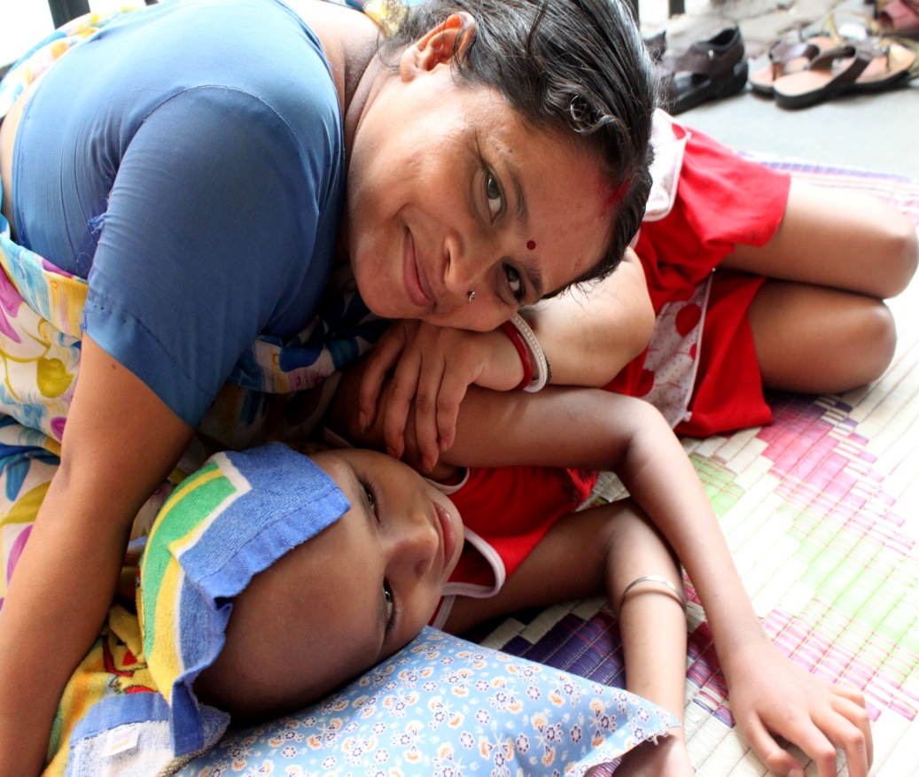
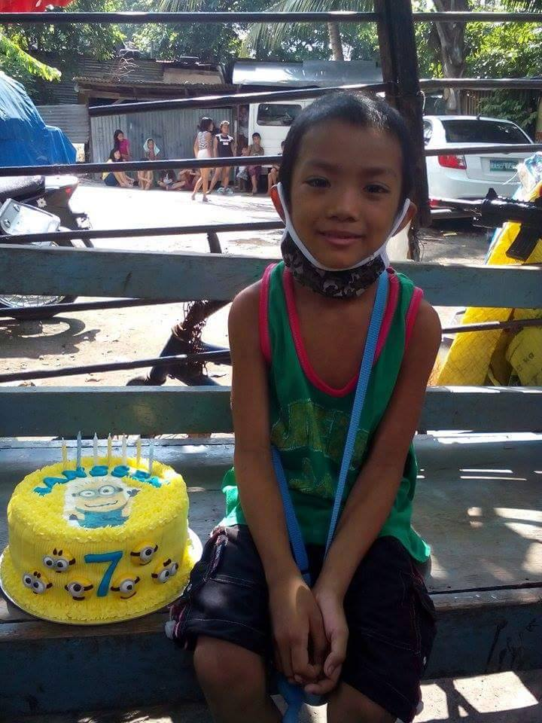
6. Bringing back childhood into their lives and ensuring a better future (e.g. educational programs. home schooling)

Slide 20
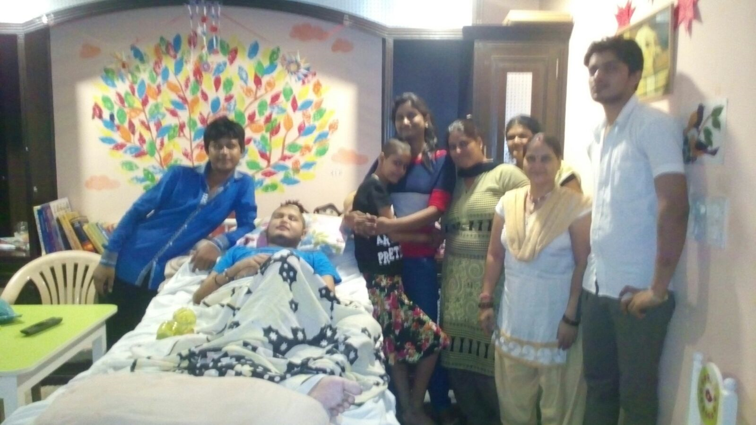
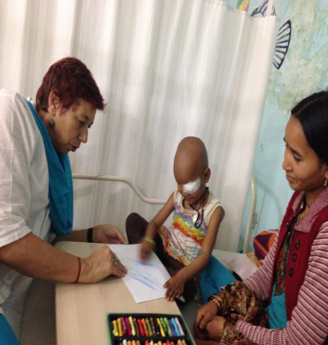
Types of support Patient and Family groups provide
7. End of Life Care & Support
Preparing the parents and family members in the terminal phase and for the reality of death.
Emotional and practical support through home visits
Funeral support and :or trqnsport back to home:
8.Grief and Bereavement Support

Slide 21
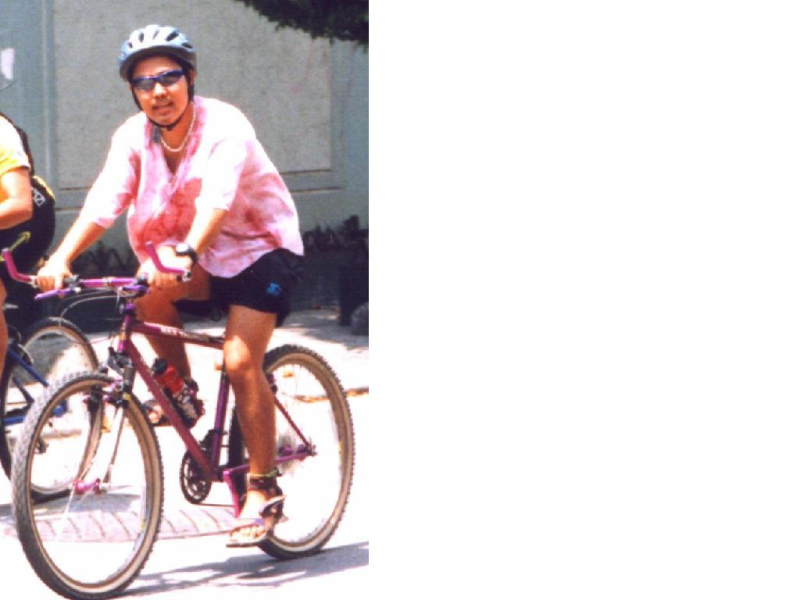
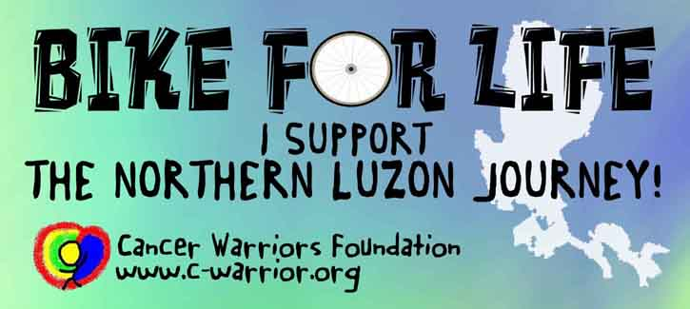
Creating a favourable and supportive environment for Pediatric Palliative Care
Creating Awareness
Mobilizing Resources
Advocacy and Alliance Building

Slide 22
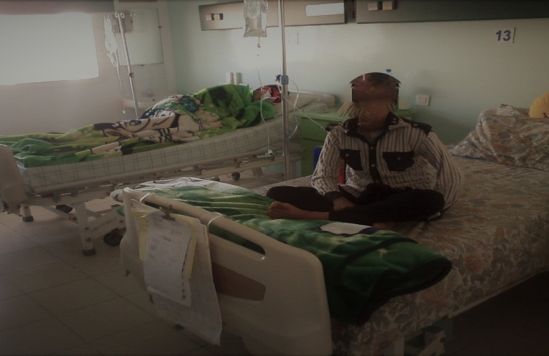
Cancer/childhood cancer is a long, devastating and often isolating journey. Palliative care support from moment of diagnosis is crucial. !!!
This need is most pronounced In low- and middle-income countries (like the Philippines), where
Myths and misconceptions abound
Overwhelming catastrophic costs is the norm
Survival outcomes are poor due to delayed diagnosis; presentation in advanced stages; refusal of treatment; abandonment; toxicity
Treatment care and support often out of reach

Slide 23
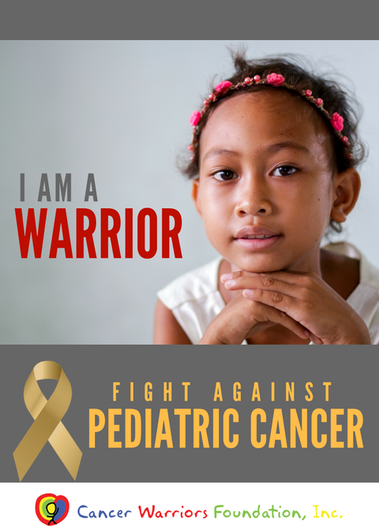
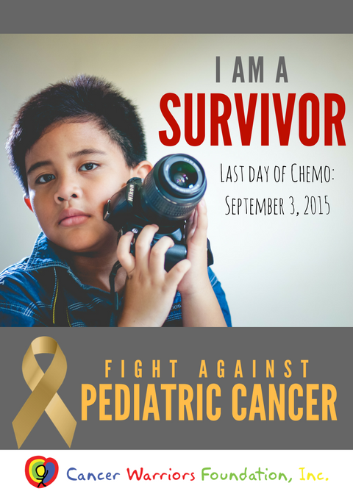
www.childhoodcancerinternational.org
menchauste@gmail.com
cancerwarriorsph@gmail.com
cancerwarriorscebu@gmail.com

Slide 24
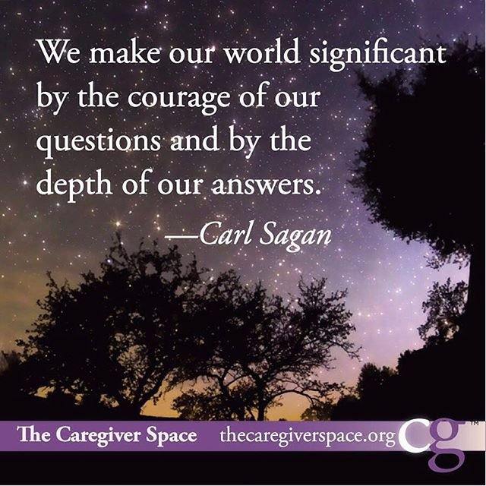

Slide 25
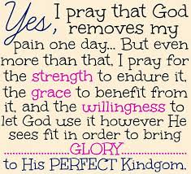

Slide 26
